Slide 1
Ancient Greece
The City States
Democracy from the Beginning

Slide 2
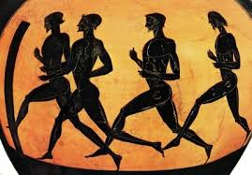
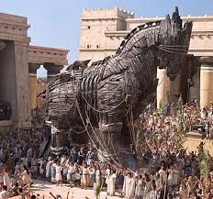
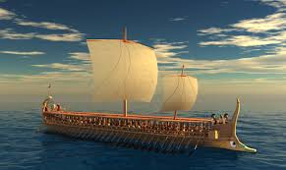
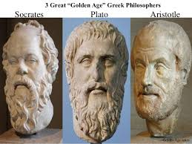
What do you think of when you hear ‘Ancient Greece?’
Ancient Greece in 18 minutes

Slide 3
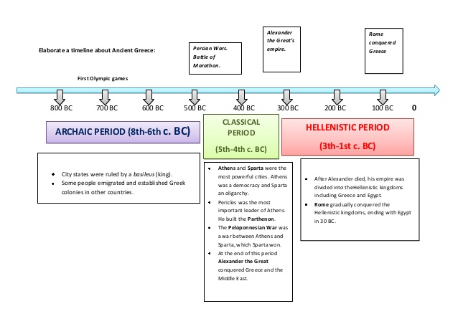
Greece Timeline
Greece 101

Slide 5
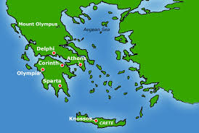
Greece
The Sea- how was it used to the Greeks’ advantage?
Transportation
Trade
War
Protection-how did they protect the city?
Long Walls (fortifications that stretched from the sea to the city
Greece is rocky and dry- not ideal for agriculture
How did they feed it’s growing population?
Imports wheat, Traded/ exported wine, olive oil and pottery

Slide 6
Greek timeline
A. 800 BCE
B. 700-500 BCE
C. 500-400 BCE
D. 490BCE (Battle of Marathon) 480BCE (Battle of Salamis)
E. 431 BCE- 404 BCE

Slide 7
The Medic Wars
Each city state in Greece was constantly at war with each other but became allies to fight foreign enemies (Medes was the name given to the Persians by the Greeks)
In the 5th century Persia tried to take over Athens (First Medic War)
This war ended in Marathon with Athens being victorious
Persians attacked again. Athenians with their War ships were victorious (Second Medic War)
The fact that Athens won these tow Wars created Greek domination (hegemony)

Slide 8
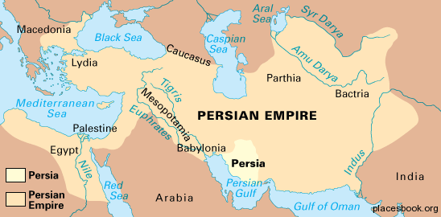
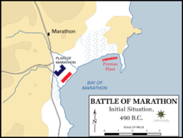
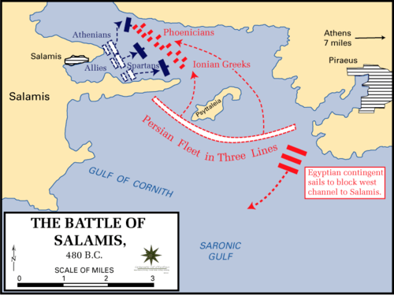
Medic Wars: Persia is the Enemy! Persia was trying to take over Greece as it expanded
Battle of Marathon
Battle of Salamis
First Medic War
490 BCE
Persians landed on plain of Marathon
Although outnumbered, Athenian hoplites (foot soldiers) had specific training for fight in formation, had home advantage = victory
Second Medic War
480 BCE
Spartans joined this Battle – fought the Persians on land
Athenians fought Persians at sea and won against the Persians in the Strait of Salamis
Greeks won due to the trireme (maneuverable warship)

Slide 9
Delian League
Formed after the Battle of Salamis to gain strength against the Persians
Wealth, resources to better defend
…. HOWEVER
Athens was the leader of this League…which caused tensions…WITH WHO?
THE SPARTANS and every other city state.

Slide 10
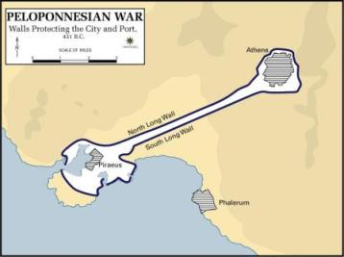
Peloponnesian War - between Athens and SParta
Before the War
First War (Archidamian War)
Many cities suffered after the Persian Wars
Led to a Thirty Year Peace (no fighting each other so they could recover)
This led to Athens becoming powerful and wealthy which was led by Pericles
With jealousy, distrust & disagreements Sparta declared war on Athens
10 years
Spartans dominated by land
Athens dominated by sea and built long walls from Athens to Piraeus
Many deaths from the plague

Slide 11
Battles between Sparta and Athens
First War

Slide 12
Peloponnesian War - between Athens and SParta
Peace of Nicias
Second War(Archidamian War)
421 BC
Athens and Sparta truce
410 - 406 BCE
Sparta gathers allies for conquer Athens
Persian help (money for warships)
405 Athens was defeated

Slide 13
Athens Defeated - https://www.youtube.com/watch?v=GjbfS8RDoYo
404 BCE Athens surrendered to the Spartans
Spartans ended the democracy and set up a new government – “Thirty Tyrants”
“Thirty Tyrants” only lasted one year to which Athenians restored democracy

Slide 14
Society in Athens
Each city state developed autonomously due to the landscape
Communication was difficult due to the mountains
Each had their own government
A citizen was defined as a free male (20% of population)
Women were not considered citizens and could not vote
Slaves and Foreigners were not citizens

Slide 15
Athens’ Sociocultural Life
4 Social Groups
Citizens (45,000)
The wives and children of citizens (105,000)
Metics (40,000)
Slaves (110, 000)
Citizens | Metics | Slaves
Men Free Over 20 years of age Born from citizens (Athenian Mother) Own land/ rule city /political life Most were peasants Some rich, some poor Had to perform military service by the age of 18 | Free Greeks who came from other cities Could not own land Had to have an Athenian sponsor Merchants or artisans-some very wealthy Pay city taxes Serve in army | Usually foreigners Some prisoners of war or captured by pirates Thoughts of as goods or objects Children automatically became slaves No rights Obey master
HOMEOWRK Page 72-75 #1-6

Slide 16
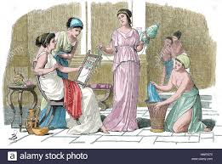
Athenian Families and Education
How do you think the roles and education of a female was different
from the males?
Wives of Citizens
Roles Passed citizenship to their sons aka. HAVE A BABY
Lived exclusively in the gynaeciun, where they weaved and took care of children
Richer wives gave orders to their slaves who completed household tasks
Poorer wives worked as nannies, general labourers or prostitutes
Education Young girls learned to accomplish household tasks and helped educate the younger children
Stayed with their mother in the gynaecium until their wedding
(around the age 15)
Married a man older than 30, who was chosen by their father.

Slide 17
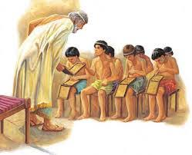
Athenian Families and Education British museum Daily life
A day in the life of Athenian
Citizens
Roles: Took care of public affairs by participating in the city’s political life
Served in the army
Oversaw farm work on their land
Education: 0-7 years old Sons of citizens stayed with their mother.
8-14 years old An educator or master, taught them reading writing, music and arithmetic
Physical activities such a wrestling and gymnastics
15-17 years old Trained for different sports
Learned the art of reasoning, delivering speeches, arguing and finally convincing

Slide 18
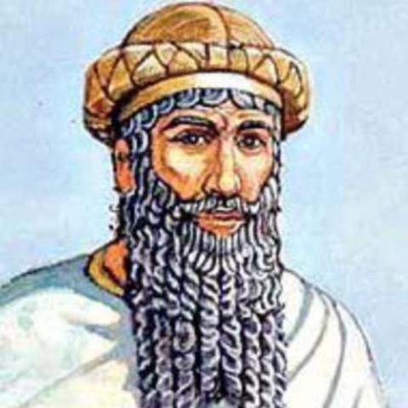
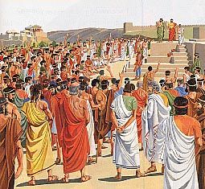
How has Democracy changed? In Mesopotamia, who ruled? Who have out orders? Did the people have a say in their daily life? VS.

Slide 19
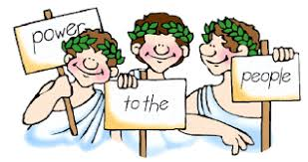
Democracy- “Power to the people”
What does Democracy Mean?
Athenian democracy consisted of a political system based on a new concept of the world and justice.
Its working were complex and included various structures that encourages the participation of all citizens
The man who came up with the idea of Democracy was Cleisthenes (end to tyranny) “Power to the people”

Slide 20
Ekklesia
All Citizens, approximately 6000
Role: vote laws, public expenses, wars, sign peace treaties, elect strategists
Drawn by lot
Drawn by lot
Boule
Council of 500
Aged 30 or over
Role: prepare legislative proposals, manage city’s day to day business, supervise strategist
1 year, renewable once
Heliaia
6000, Age 30 and over
Role: popular court
Term: unlimited
Election
Drawn by lot
Archons
10 Citizens
Role: Preside over the court
Term: 1 Year
Strategists
10 citizens
Role: make sure laws are applied
1 year term

Slide 21
Greek Mythology
Greek Gods and Goddess was their belief system or religion.
Greeks were Polytheistic (multiple Gods)
There were 12 deities (Gods/ Goddesses)
Zeus 8. Artemis
Hera 9. Hermes
Poseidon 10. Hestia/ Dionysus
Demeter 11 Hades / Hephaestus (depending on the story teller)
Athena
Ares
Apollo

Slide 22
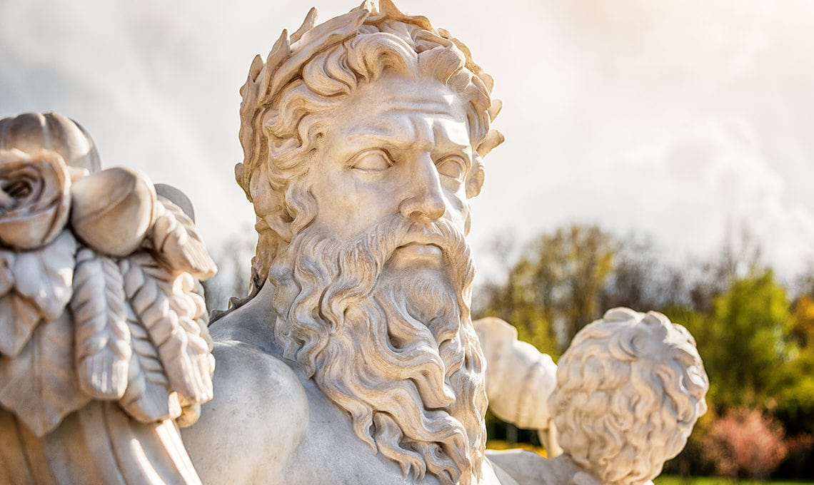
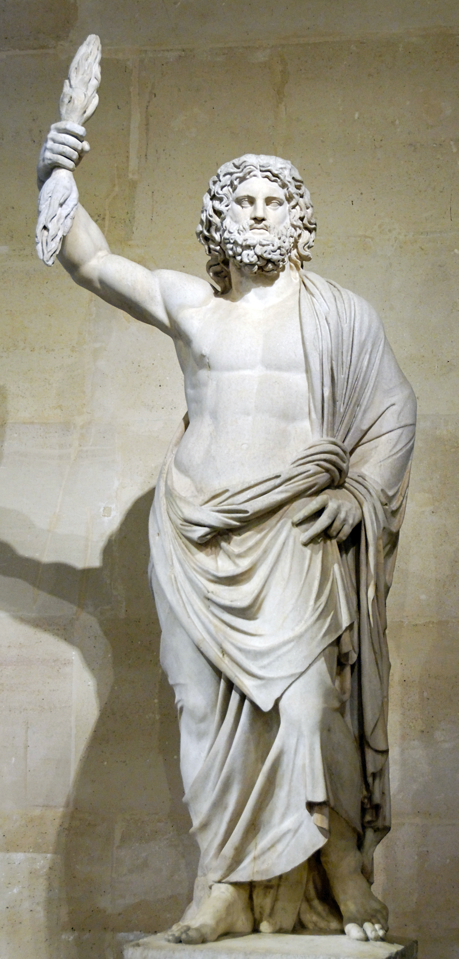
ZEUS – KING of the gods
Ruled the entire universe
He was not afraid of anything
Symbol: Lightening bolt
He could give and take away titles from Gods and Goddesses
God of: sky, lightening, order and justice
Had many children : Ares, Hephaestus, (Hermes, Apollo & Artemis, Hercules, with a different person)

Slide 23
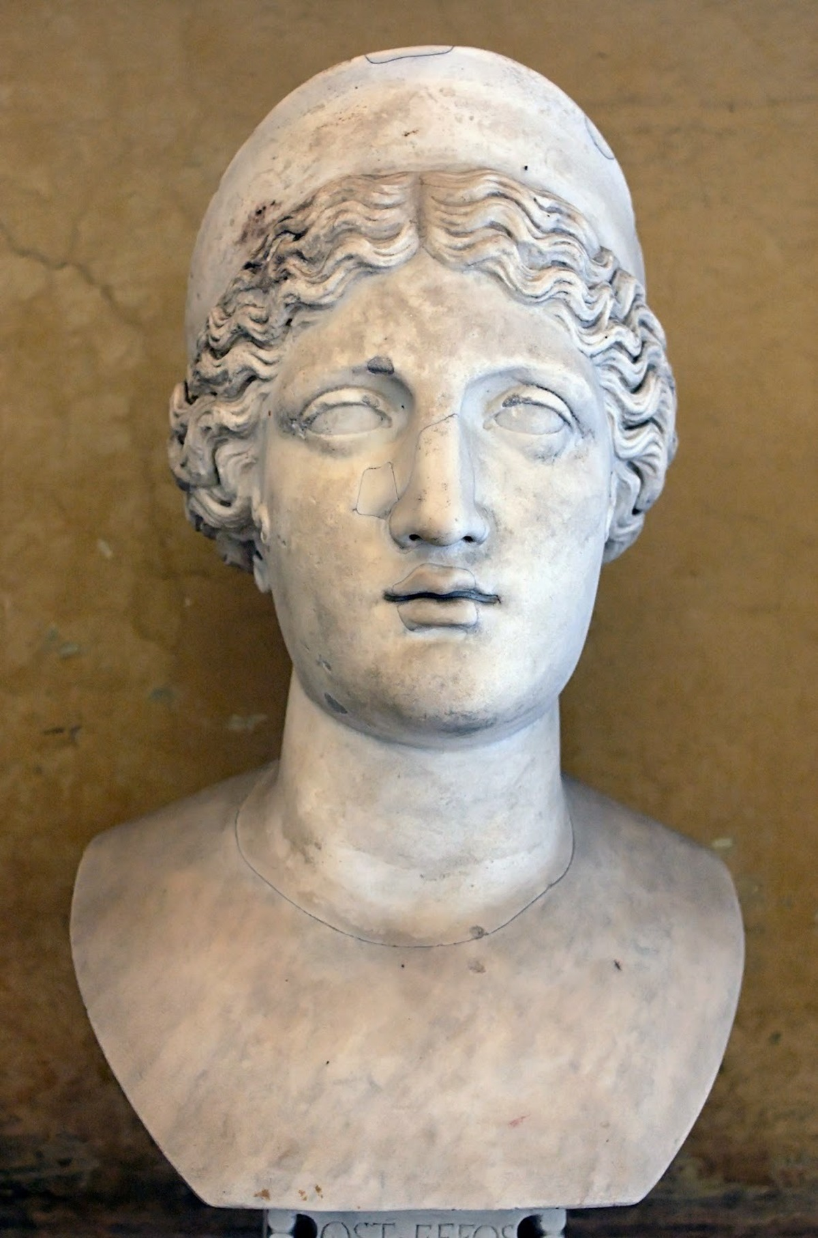
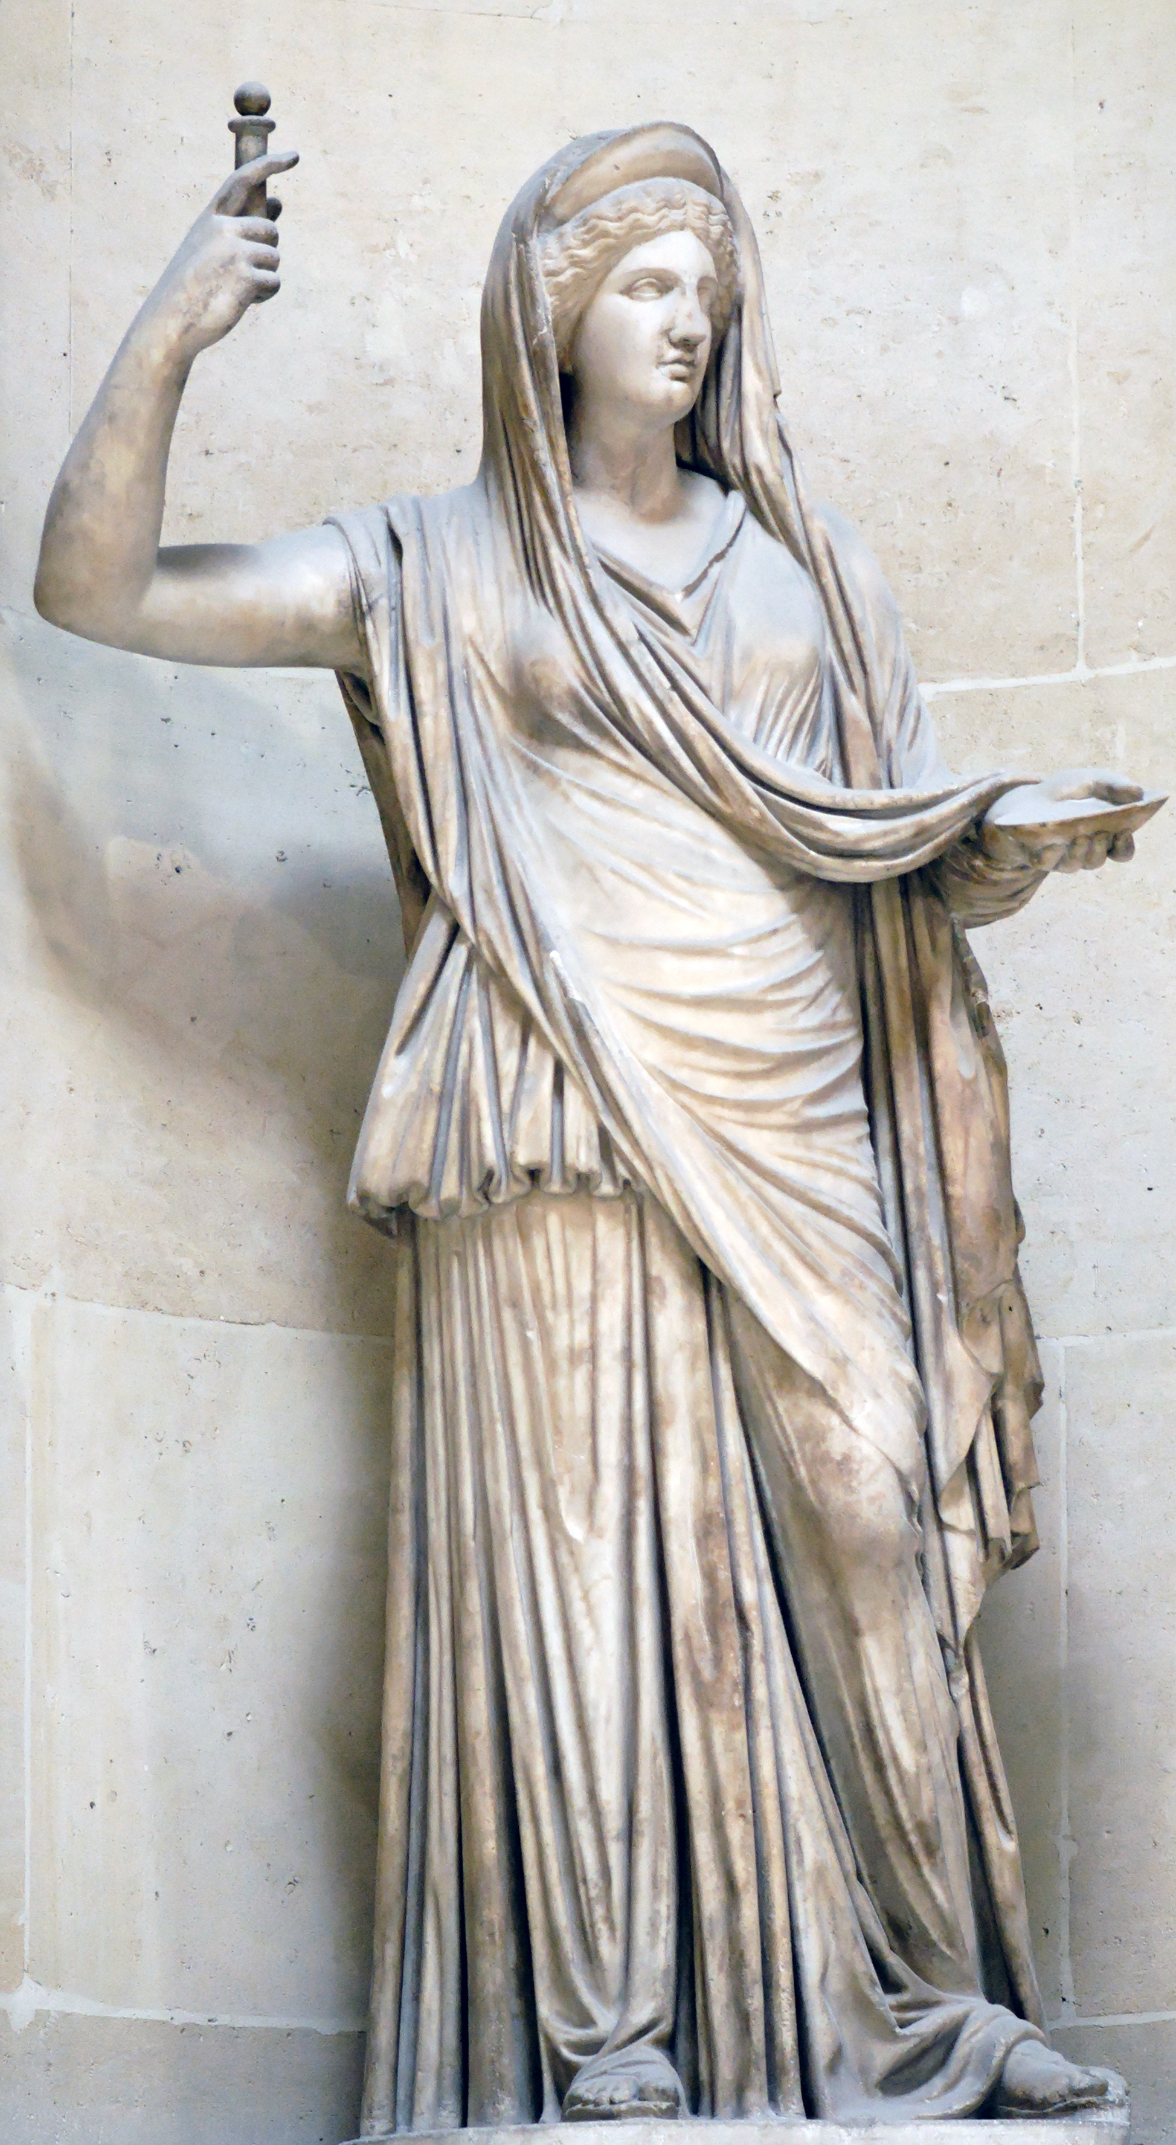
Hera – Queen of the Gods
Zeus’ sister and also his wife
Children: Hephaestus
Goddess of marriage
She was not very well liked

Slide 24
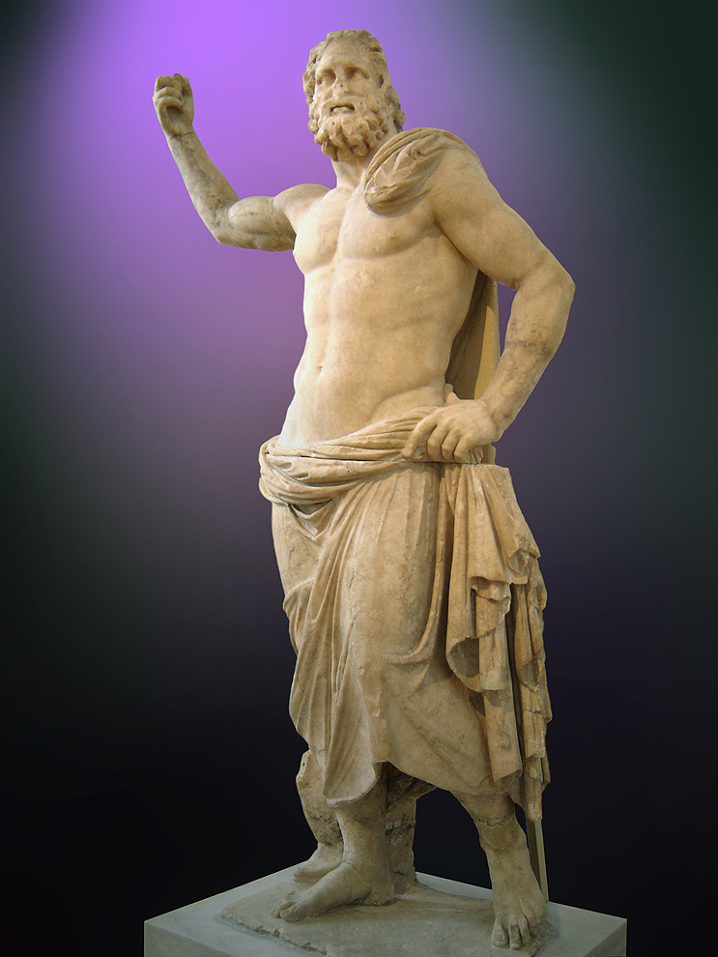
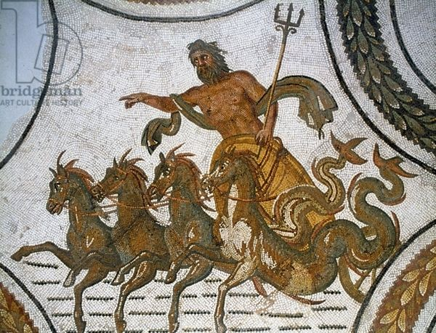
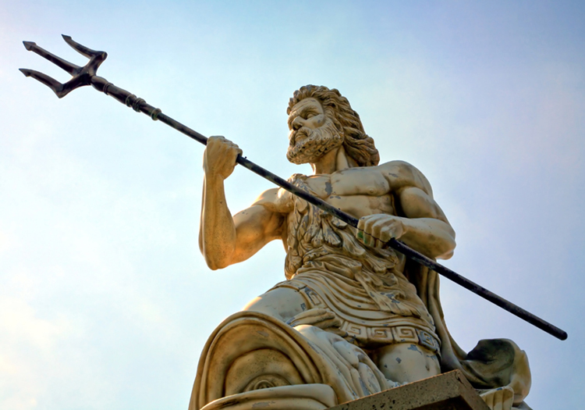
Poseidon
God of the seas, water, storms , hurricanes, etc.
Brother of Hades and Zeus
Symbol: Trident
Known to be a moody and bad tempered

Slide 25
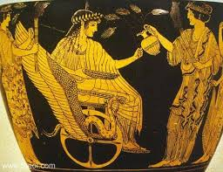
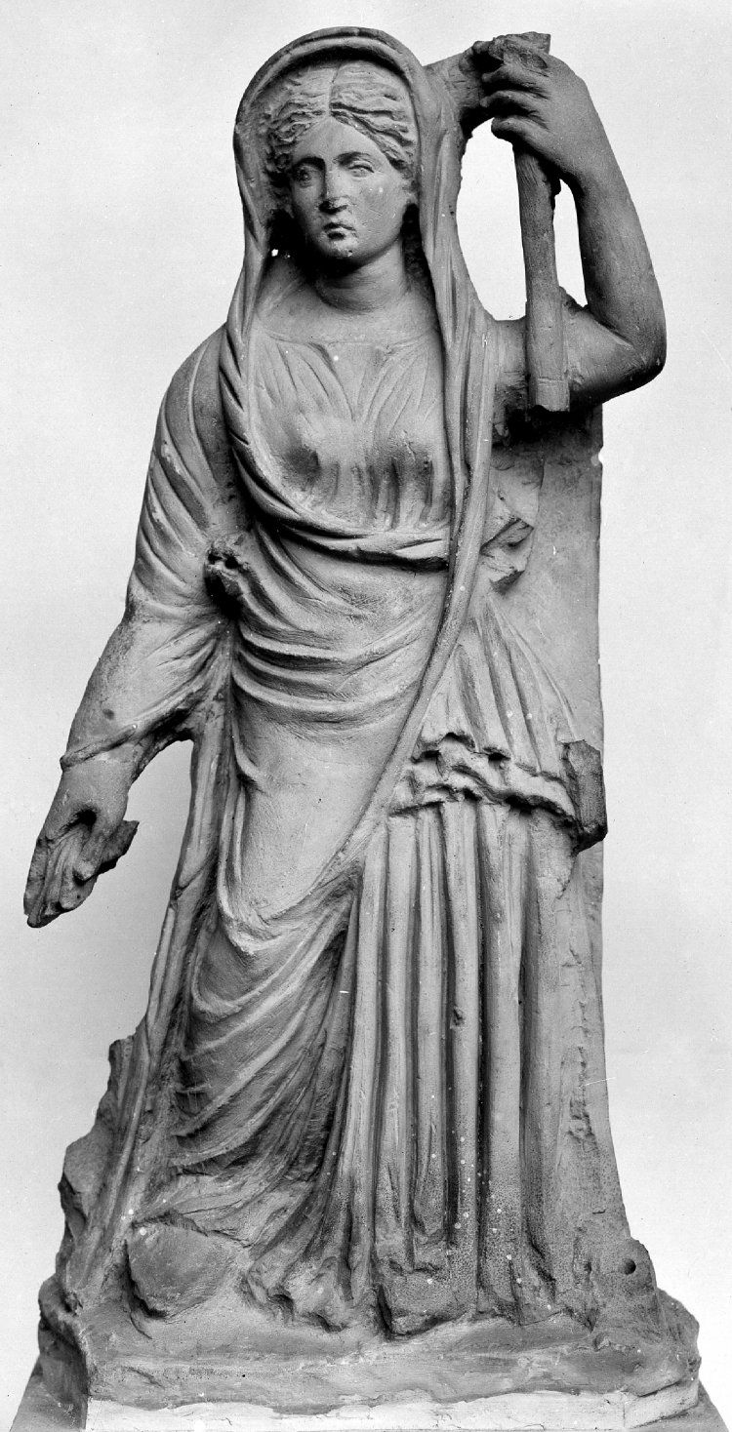
DemEter
Goddess of harvest, grains and the earths fertility
Hades abducted her daughter, therefore all living things died. Zeus ( the father) intervened and sent Hermes to bring her daughter back.
She was known as the “Good Goddess”
Through art, she is pictures with a wreath and corn

