Slide 1
Good morning! October 3 – Day 4 Group 27
Notes
Worksheets

Slide 2
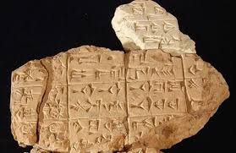
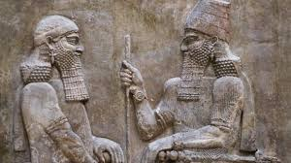
A Civilization of Writing: Mesopotamia

Slide 3
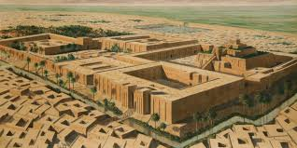
What is a Civilization?
In general, a civilization refers to organized societies that have social, religious, artistic, scientific, etc. elements in common.

Slide 4
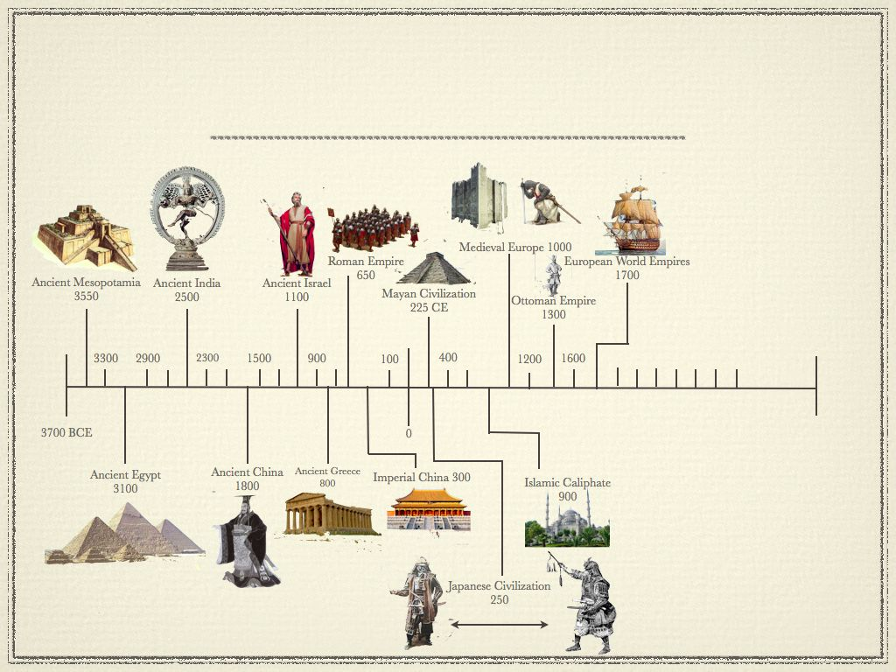
When?

Slide 5
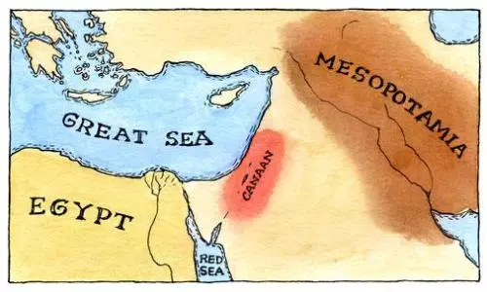
Early Civilizations
Mesopotamian Civilization (around 3500 BCE)
Valley of the Tigris and Euphrates
Why Here?
Located in the Fertile Crescent (Remember?).
Located between two rivers (constant source of water).
Spring rains and melting snow flooded the floor of the valley each year (leaving behind sediments) making it rich and fertile.
Numerous marshes, which attracted game and provided fish.

Slide 6
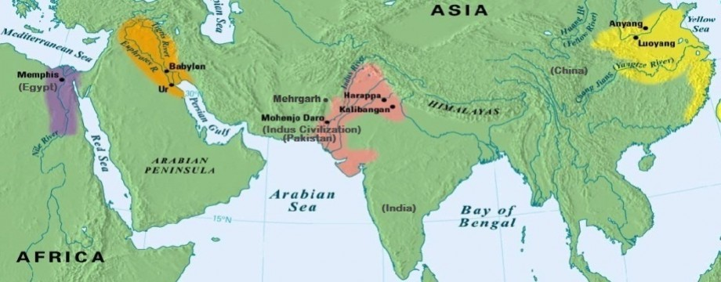
Early Civilizations (continued)
* ALL emerged in large valleys crossed by major rivers*
Civilization of the Nile Valley (around 3000 BCE)
Nile Valley
Civilization of the Indus Valley (around 2500 BCE)
Indus Valley
Chinese Civilization (around 2000 BCE)
Hoang-Ho Valley
What do these 4 civilizations have in common?

Slide 7
Mesopotamia: From Nomads to Farmers
From Nomads to Farmers
Follow along with the handout and answers the questions
Answers
1. Land between two rivers
2. Hold water to prevent flood
3. To know when the floods will come
4. Keep track of trades
5. Clay tablets
6. Cuneiform
7. Ziggurat
8. Slaves
9. Scribe
10. Judgements
trade with other cities
choses the farmers
Repairs the temples
11. burdens
12. time

Slide 8
Mesopotamia: The Land Between the Rivers
Complete
Worksheet 3
Page 35 in the text
#2-3

Slide 9
Good morning! October 3 – Day 4 Group 21
Bingo
Notes – Mesopotamian Writing
Cuneiform Activity

Slide 10
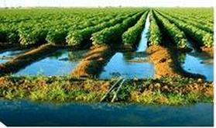
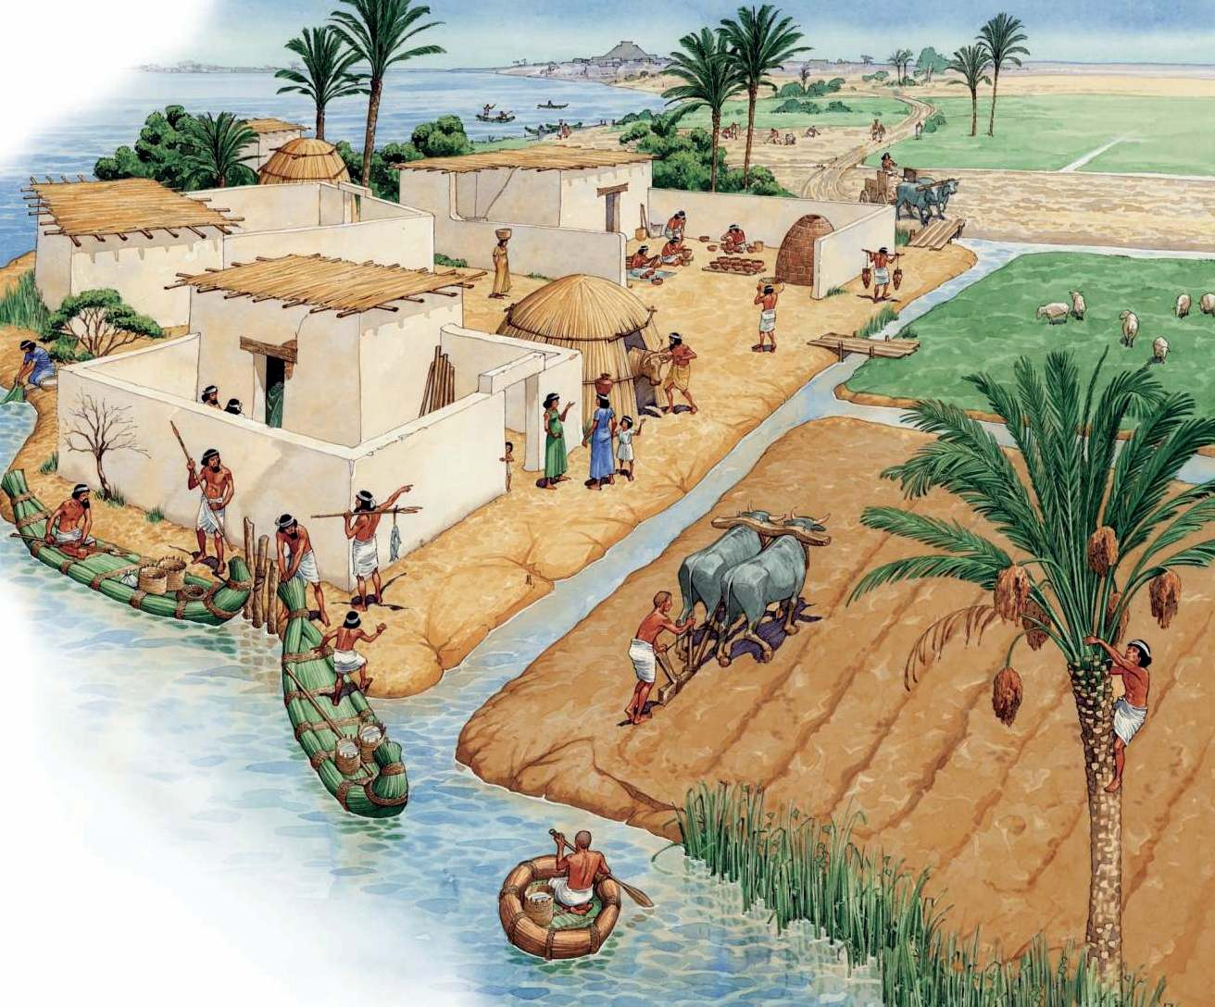
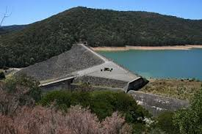
Irrigation System
Regular flood inundated the land leaving behind sediments and fertile land. Mesopotamians learned to tame the flood and use the water.
Farmers learned to dig tanks in the ground to store some of the flood water for later use…
They also built dikes to create storage reservoirs for the water…
Constructed many irrigation canals across the flat flood plain to carry water to the fields…

Slide 11
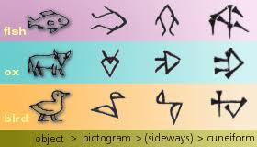
Mesopotamia
The History of Writing
Things to consider why you are watching
Why did writing begin?
What were they keeping track of?
How do we still have these records?

Slide 12
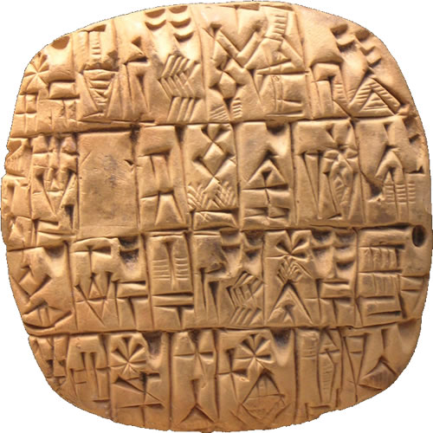
The Need for Records
To keep records of the foods and goods kept in their stores and warehouses…
Record transactions because Kings wanted to issue orders and keep accounts of their wars…
The transfer of property and the regulation of society demanded some form of keeping records…

Slide 13
The Development of Writing
Thousands of written records have been found by archaeologists in Mesopotamia (most were written on clay tablets)…
Stone was used if the record was meant to be more permanent…
Scholars have learned how to translate most of them :)

Slide 14
What do these symbols mean?
You did not need any words to understand their meaning
Mesopotamians did the same thing with Pictograms
Try to write this sentence with a pictogram
‘This wagon contains 50 bricks for the king and 15 containers for the village merchant.’

Slide 15
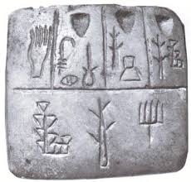
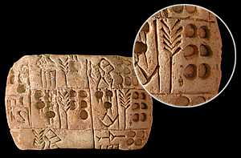
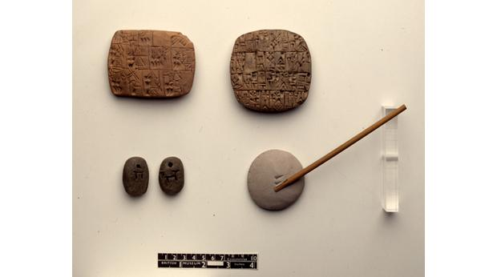
The Development of Writing
About 3000 BCE “pictograph signs” were used to record stories…
Each sign was a simple picture of the object (about 1200 signs were used to record objects or actions)…
A sharpened reed was used to scratch these signs onto a slab of wet clay (later the slab would be baked hard to be kept as a permanent record)…
What do you think the pictographs in the picture above represent?

Slide 16
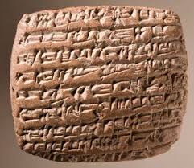
The Development of Writing (continued)
After about 2500 BCE a wedge-shaped stylus was used to press the signs into the clay (which was faster)…
This type of writing is called “cuneiform”…
The pictographs were changed into groups of impressions made by the stylus in the clay…

Slide 17
The Development of Writing (continued)
By about 2000 BCE, the number of signs that the scribes had to learn had been reduced to about 600…
Early records were written in vertical columns starting at the top right of the clay tablet (but scribes later found it easier to make the stylus marks in horizontal rows starting from the left side)…

Slide 18
The Development of Writing (continued)
Finally, scribes found that a sign could denote a sound…
Each sign represented a syllable (two or more signs could be combined to make a word) = phonetic symbols…
This system was not as simple as our alphabet but it allowed information to be recorded more easily!

Slide 19
Create your name tag using Sumerian Cuneiform
Complete page 36-39 1-8, skip 4

Slide 20
Tuesday, October 8th – Day 7
Correct Worksheets
Notes
Videos

Slide 21
Religion: Mesopotamia vs. Ancient Egypt
Mesopotamia
Ancient Egypt
Polytheists (belief in more than one God)
Represented a force of nature (fire, sun, moon, etc.)
Immortal and had special powers but, lived like humans
Gods shaped their destinies
Animal sacrifices, praying, food and wine to win their favor
King received power from Gods
Honored many Gods – certain gods were respected
Life after death → eternal kingdom which they enjoyed peace and happiness
Weighing of the heart determined your fate
Mummification to prepare them for the afterlife.

Slide 22
Social Hierarchy and their Roles
Kings & Nobles
Priests & Middle Class
Top of the social hierarchy
King had supreme power
After wars the strongest warlord became king (eventually became hereditary)
Surrounded by nobles (army leaders, palace officials
Owned land
Nobles advised the King
Scribes, officials (gov’t workers) and priests
Merchants owned their own company
Scribes were highly respected
Some may have become wealthy and owned a small piece of land

Slide 23
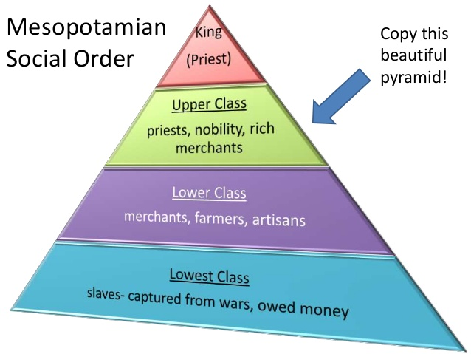
Social Hierarchy and their Roles
Lower Class
Lowest Class
Those who kept the city operating:
Farmers
Bakers
Fisherman
Soldiers
All could climb the social ladder
Rarely owned land
Farmers
Salves did the hard work and were prisoners of war or were free men but were enslaved to repay their debt

Slide 24
Trade
Surplus
Trading network with other cities
Eventually payments were made with gold and silver
First millennium is when coins started to appear
Wheel helped tremendously to carry goods
What products do we see in Mesopotamia?
What products did Mesopotamia need to import?

Slide 25
Innovations
Mathematics
Geometry led to boundary markers that were erased from the floods
Numbers 1-60
They divided their hour into 60 minutes and 1 minute into 60 seconds
The wheel
Writing (changed overtime)
Astronomy
Discovered the dates or equinox (spring and autumn)
Divided the year into 12 months
12 months in a year (so did the Egyptians)

Slide 26
Concepts to Review – IT DOES NOT INCLUDE EVERYTHING TO STUDY
4 civilizations and their dates
Religious beliefs between Mesopotamia and Ancient Eqypt
Social classes and their roles
Innovations
Writing (please re watch this video https://www.youtube.com/watch?v=HyjLt_RGEww)
Hammurabi’s Code of Law

