Slide 1
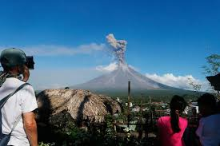
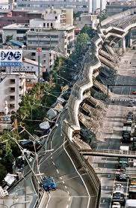
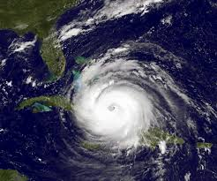
Natural Hazards
In an Urban Environment

Slide 2
Natural Hazard vs. Natural Phenomenon
Let’s take a look at a few on page 4 of our workbook:
Hurricane
Tornado
Volcano
Earthquake
Natural hazard is related to a natural phenomena that impacts a population – but has not yet happened.
They can be: volcanoes, earthquakes, tornados → as long as they impact a population
Previous classes we mentioned Hurricane Dorian: https://www.cnn.com/2019/09/03/us/hurricane-dorian-tuesday-wxc/index.html
Natural Disasters/Hazards:
Cannot be stopped (can not stop a tsunami or a volcano)
Cannot happen in uninhabited areas. Why not?
Is not an artificial risk (human activities such as a power plant → radiation , oil industry → contaminated water)

Slide 3
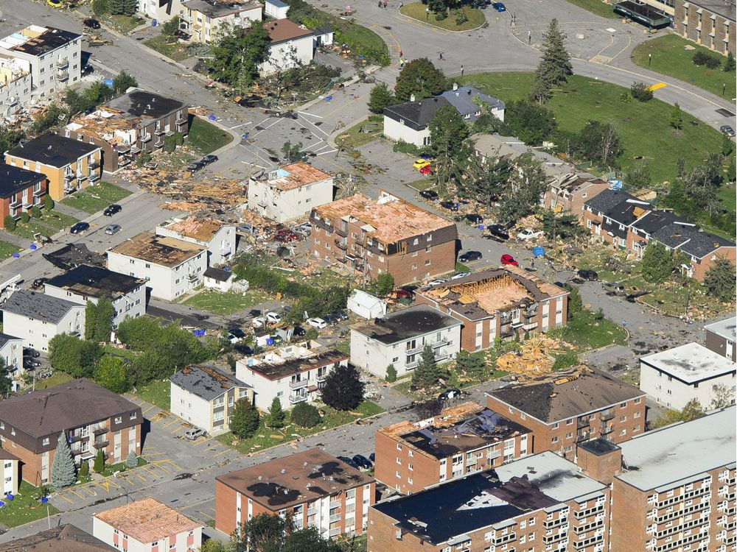
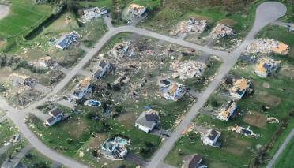
Natural Hazards at home IN Quebec
Tornadoes in the Outaouais, September 2018
Right: Hull, Quebec (near Philemon Wright High School)
Below: Dunrobin, Ottawa

Slide 4
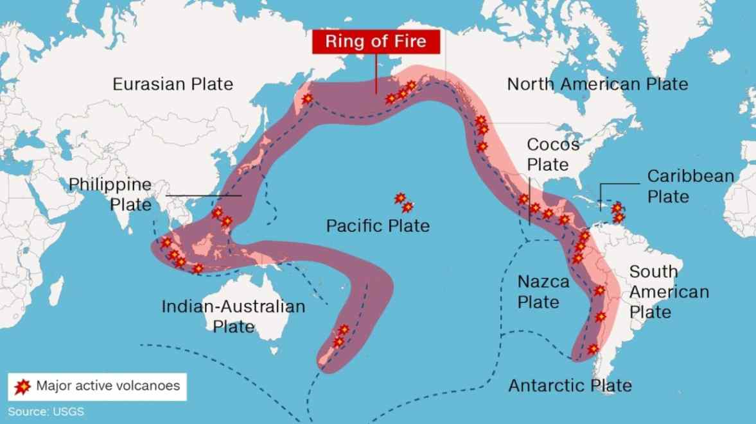
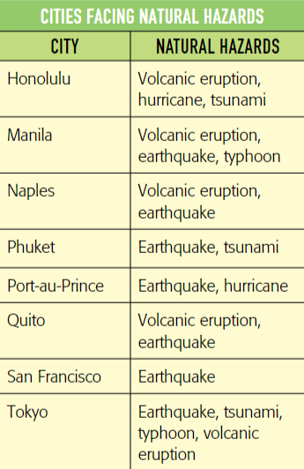
Cities at Risk
Some cities are more at risk of natural hazards due to their location (seismic activity, volcano, pathway of hurricane, typhoons or cyclones)
History of Hurricanes:

Slide 5
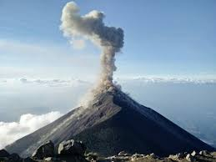
Managing Risk in an Urban Environment
Cities are sometimes located near risk or dangerous areas and may face many types of natural hazards.
But they do not always have the necessary means to protect their populations.
How can cities prepare themselves to confront the natural hazards that threaten them?
Do all regions of the world face natural hazards?
Do all countries have the same ability to overcome a natural disaster?
Complete page 67 #1-4

Slide 6
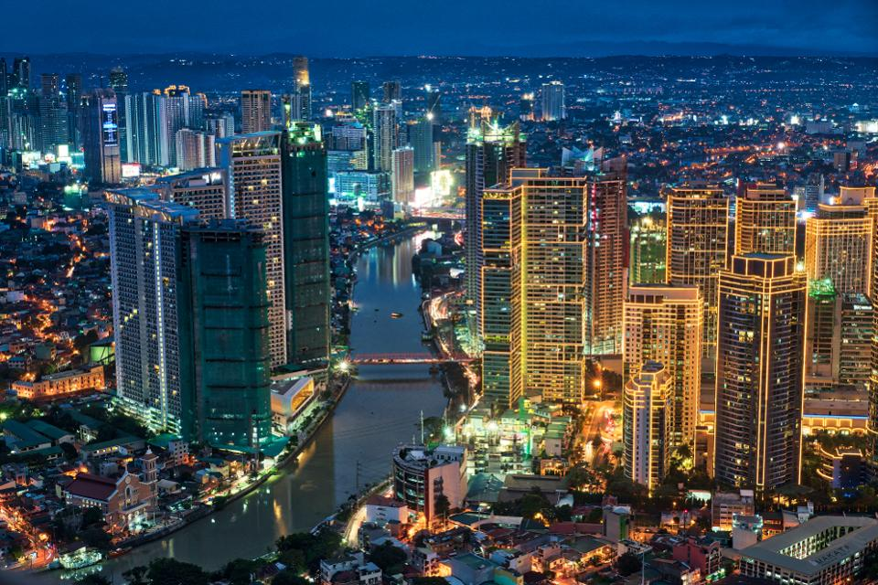
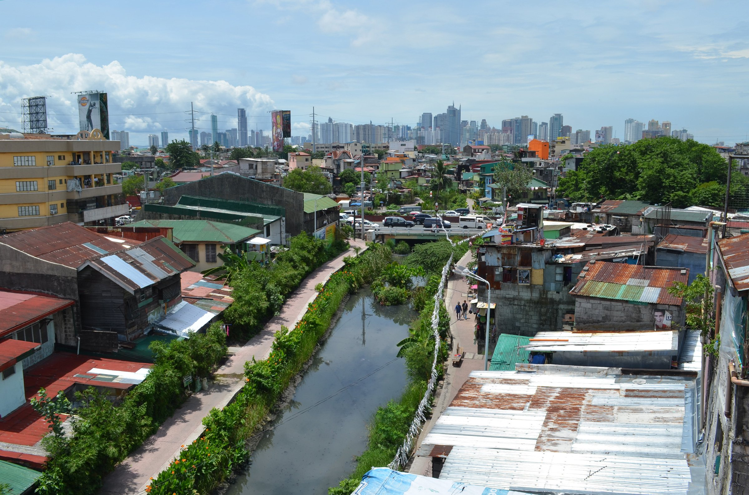
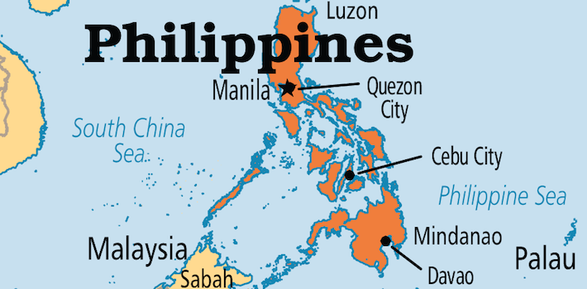
Manila

Slide 7
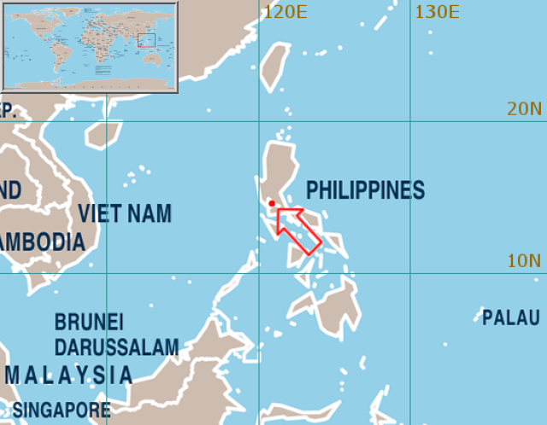
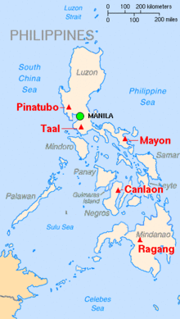
Manila – A city at risk
Located on the Ring of Fire
The earthquakes under the ground causes tsunamis
Active volcanoes
Typhoon zone ( same as a hurricane - different places call it differently)
Warm water conditions encourages the formation of typhoons
30 typhoons hit the Philippines each year

Slide 8
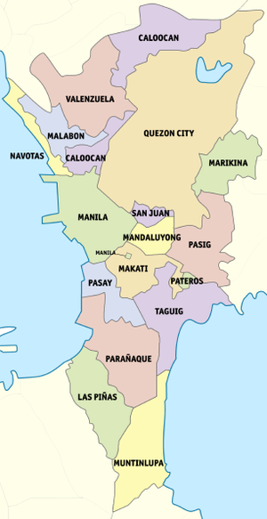
Population demographic
Metro (metropolis) Manila
Composed of 16 cities and 1 municipality
It is the capital region
Large population lead to low income populations living in tight living conditions (p.16 #28)
Population increase graph on page 16

Slide 9
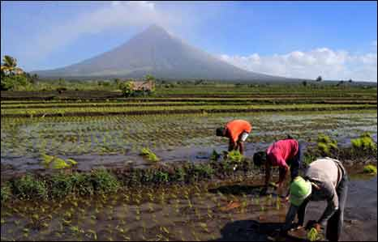
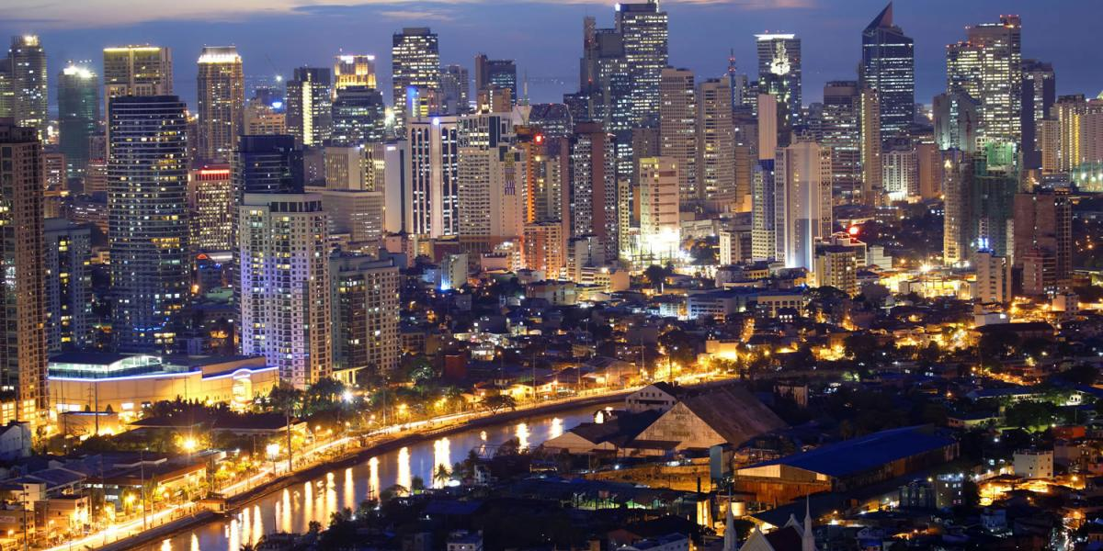
Why do people go to Manila?
Fertile land which was used for agriculture (rice, corn, sugarcane, bananas, coffee, mango)
Floods and ash from volcanoes would benefit the soil (increase fertility)
Today, many factories are located in the Metro Manila = more people move to the city

Slide 10
Warm up QUESTIONS
Why is Manila prone to Natural Hazards?
Why is there a large population that is Impacted?
What Country is Manila in?
Answer: Ring of Fire, Active volcanoes
Answer: Slums have low infrastructure, high Density
Answer: Philippines

Slide 11
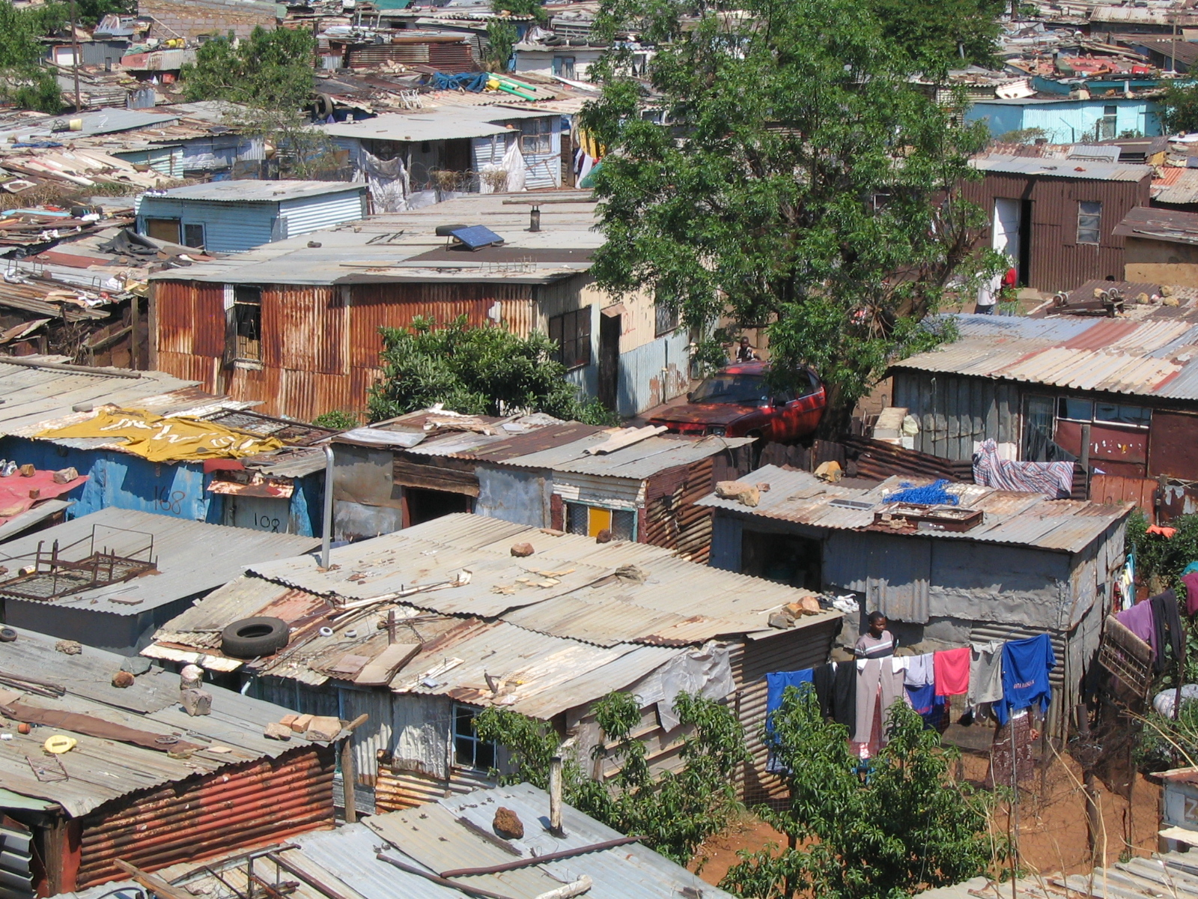
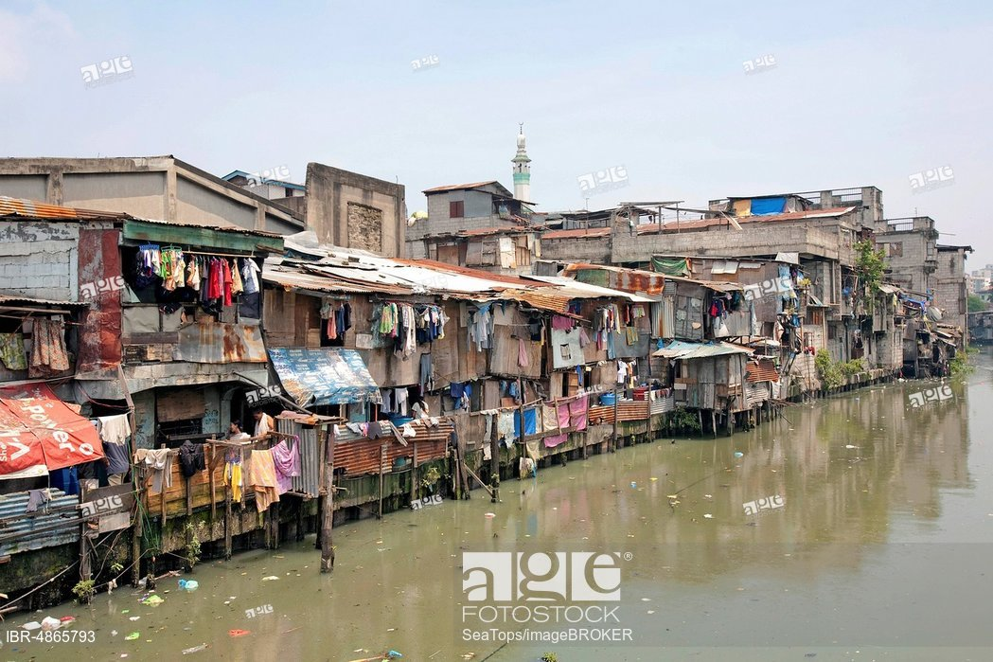
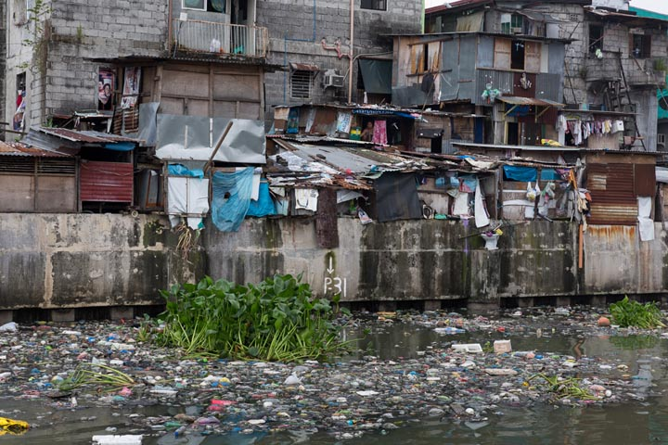
Manila: A developing Country
A developing country is when the majority of the population does not have a great standard of living
Too many people and not enough jobs
4 million people live in the slums
a very poor area with no running water or sewage system
Unofficially developed (illegal)
WHY ARE THOSE LIVING IN SLUMS IMPACTED THE MOST?
Homes build in flood zones that are also unstable
https://www.google.com/maps/@14.5888413,120.9594299,3a,60y,191.67h,79.21t/data=!3m6!1e1!3m4!1sBDRR6VBQ_GT-n4KReKxJZw!2e0!7i13312!8i6656

Slide 12
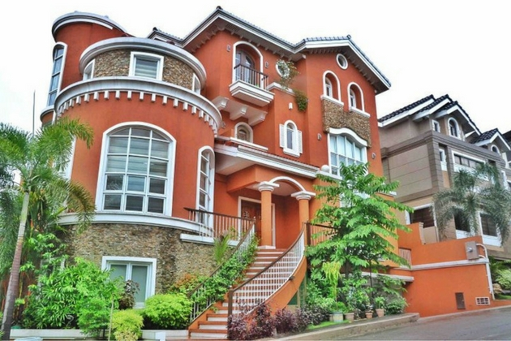
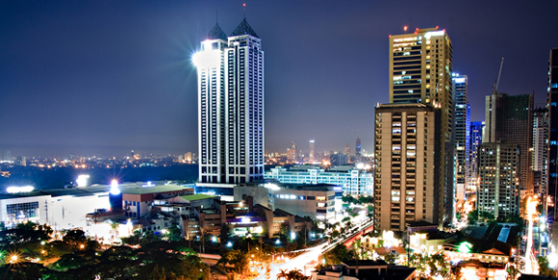
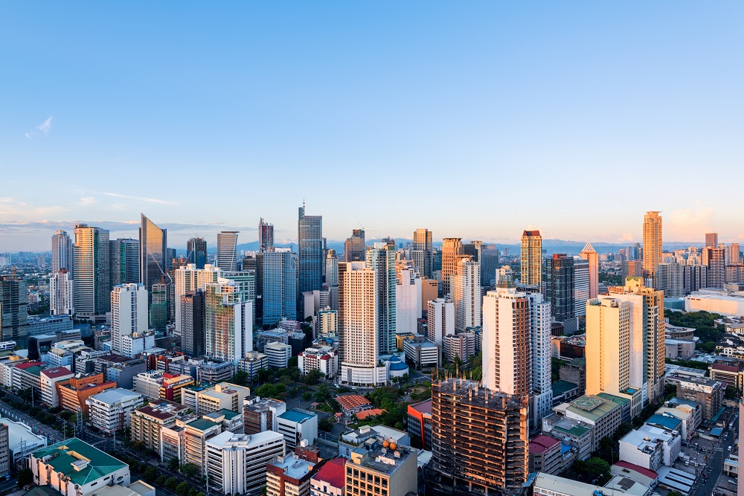
Downtown Manila
Business district
Shopping venues
Hotels
Luxury boutiques
WHY WOULD THESE BUILDINGS NOT BE AS DAMAGED COMPARED TO THOSE IN THE SLUM?
Strategically planned
Wealthy = more money for infrastructure

Slide 13
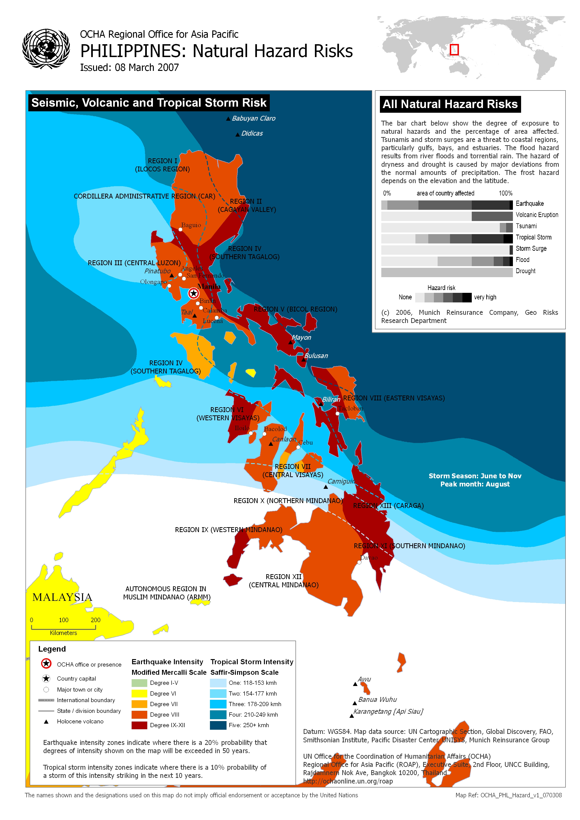
The people of Manila vs. Natural Hazards
Why is Manila so largely impacted by natural disasters?
High population
Ring of fire
Page 19 – population density
What are the consequences?
Let’s look at page 20 in the workbook

Slide 14
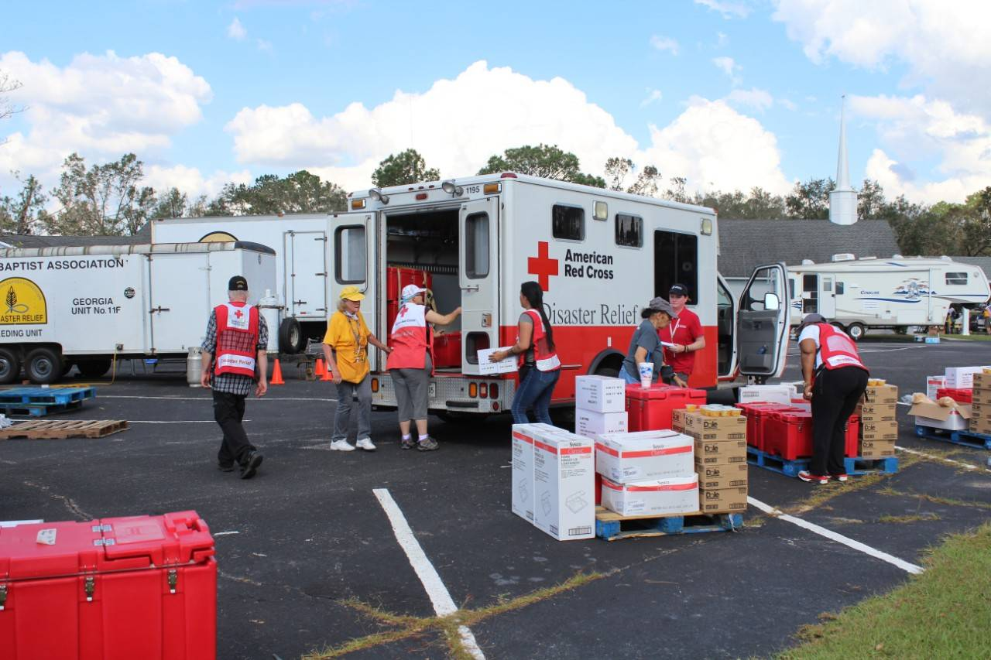
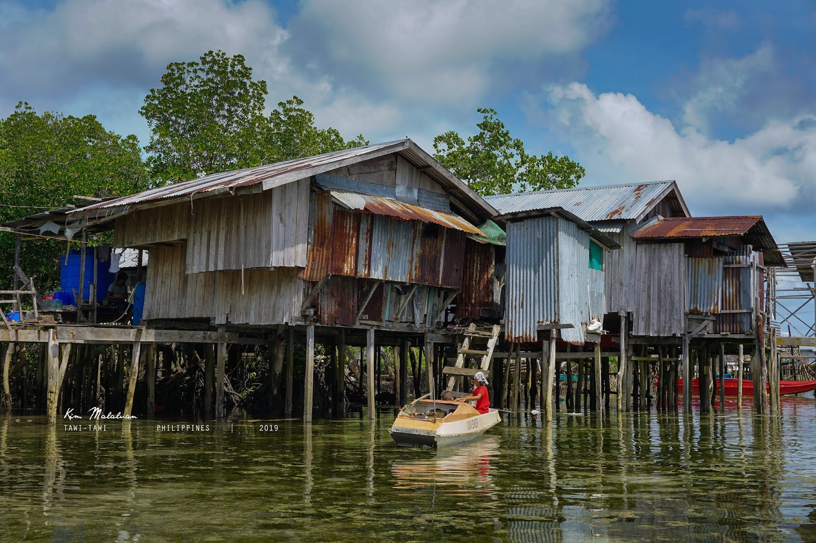
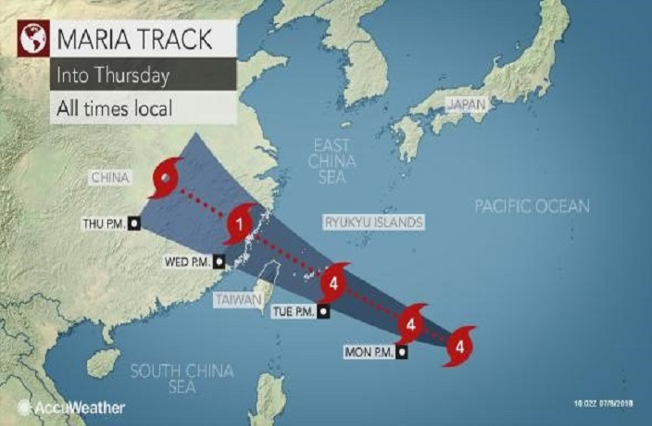
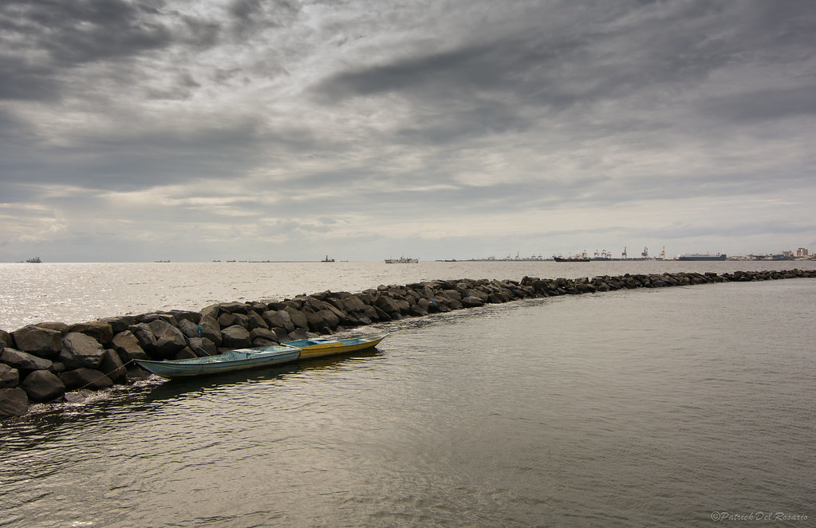
Before, During and after a Natural hazard: Manila
Before : Planning (page 24)
Preventative strategies:
Stilts → prevent water from flooding homes
Lava wall → steer lava away fro homes
Breakwaters → break ocean waves
During:
Informing the population with:
Warning signs → earthquake, sulphuric gas
Informed prediction → saving lives
Trajectories → hourly information for residents
After a natural disaster there is a period of economic and social instability (uncertainty).
→ no resources to help repair damage which leads to international aid
After:
Aid:
Red Cross → medication, food, water and camps
Doctors without borders → treatment for population
Government aid → money

Slide 15
Earthquakes: Developed Vs. Developing Country
Mexico: Sept. 7, 2017
Death toll: 217
Richter Scale: 8.0
Affected: 1.5 million, 41,000 homes damaged, 1.8 lost power, restored quickly
Aftermath: rescue efforts began quickly, despite recent hurricane, machines used to rescue trapped survivors
BEFORE: a warning siren was sounded giving Mexico City resident nearly 2 minutes to escape buildings, not all Mexican citizens have access to warnings.
Port-au-Prince, Haiti January 12, 2010
Death Toll: >300,000
Richter Scale: 7.0
Affected: 3 million, 1 million homeless
Aftermath: little aid available, people trapped for days or not rescued at all, power not restored, roads blocked
WHY?
Without adequate reinforcement, the buildings disintegrated under the force of the quake, killing or trapping their occupants.
Financial & medical aid was limited

Slide 16
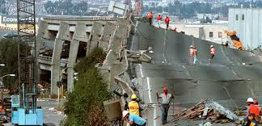
The Next Big One

Slide 17
Consequences
Before and After Photos of Hurricane Katrina

Slide 18
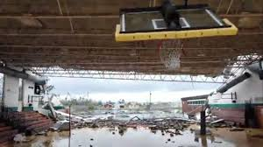
Inequalities in Coping with Natural Hazards
What human factors will determine how much damage a city will face during a natural disaster?
What is the population density of the disaster area?
Is it a large city where thousands of families live in slums?
Are there any preventive measures in place to protect the public?
Does the city have warning systems and evacuation plans for its inhabitants?
Can the buildings withstand earthquakes?

Slide 19
Consequences
The consequences of a natural disaster for a country and its ability to recover from it depend heavily on the country’s level of development.
Wealthy countries can usually expect life to return to normal within a few weeks or months.
Poor countries, on the other hand, do not have the necessary means to return to normal life.
In some cases, it can take a poor country years to recover from a disaster.

Slide 20
Dealing with natural hazards
How do cities prepare for a natural hazard to prevent casualties?
What are the consequences of Natural Hazards in an urban environment?
What recovery methods are in place when a natural disaster strikes?
-seismic stations-for volcanos and earthquakes
-Satellite images
-Warnings- earthquake and tsunami
-Evacuations
-Earthquake resistant construction
-Reinforce with steel
-Fireproof construction
-avalanche walls
-tsunami walls
-levees
-collapsed buildings, schools, homes -power outages -deaths or injuries -ground pollution -gas lines break-fires -power plant explosions -flooding -schools closed -damaged hospitals
-search and rescue
-trucks, cranes to lift walls/rubble
-set up safe zones
-insurance
-rebuilding
-supplies (food, water)
-repair hydro lines (restore power)
-moving people to safer buildings (hospitals)
-Red Cross

Slide 21
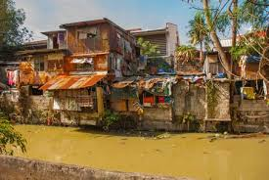
Developed
Developing
Which house is more likely to suffer damages after an earthquake?
Developing
Which house likely has insurance?
Developed
If an earthquake destroyed both houses which country would be able to send rescue teams and health care right away?
Developed
Which house will cost more money to repair if it did get hit by an earthquake?
Developed
Why?

Slide 22
Recovery
RICH COUNTRY (developed)
Health care system usually comes to the aid of victims quite quickly
Emergency services promptly respond to the public's needs.
Most victims are covered by an insurance policy that will help them pay for any damages.
Can afford a new place to live, new furniture and appliances, etc.
POOR COUNTRIES (Developing)
Health care system is sometimes inadequate even before a disaster strikes.
During disaster system and emergency services become almost non-existent.
Very few people can afford insurance.
The governments of these countries do not necessarily have the financial means to help the victims of a disaster.
International aid comes to the rescue.
International and humanitarian organizations arrive on the scene to offer first aid and temporary shelters, and organize help. help to coordinate any aid being provided.
Organizations distribute food and water, and make sure that medical care is available.
Complete page 78-79 #1-4

Slide 23
Study Guide
Natural Hazards vs. Artificial Risks
Ring of Fire (know the location)
Developing vs. Developed countries
Before, During and After a natural hazard
Natural Disasters that have occurred
Manila
Please use your notes and workbook to help you study!

Slide 24
Where in the world – Practice for Test
Italy **
Philippines **
Indonesia
United States **
Hawaii **
Japan
San Francisco
Quito
Manila
Port au Prince
Naples
13. Mauritania
14. Morocco
Malawi
Ireland
Taiwan
Lesotho
EL Salvador
Guyana
Ivory Coast
Finland

