Slide 1
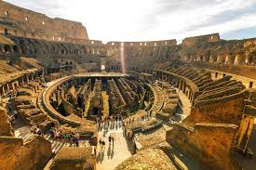
ROME
Romanization- The Rise and Fall of Europe’s Greatest Empire

Slide 2
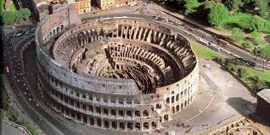
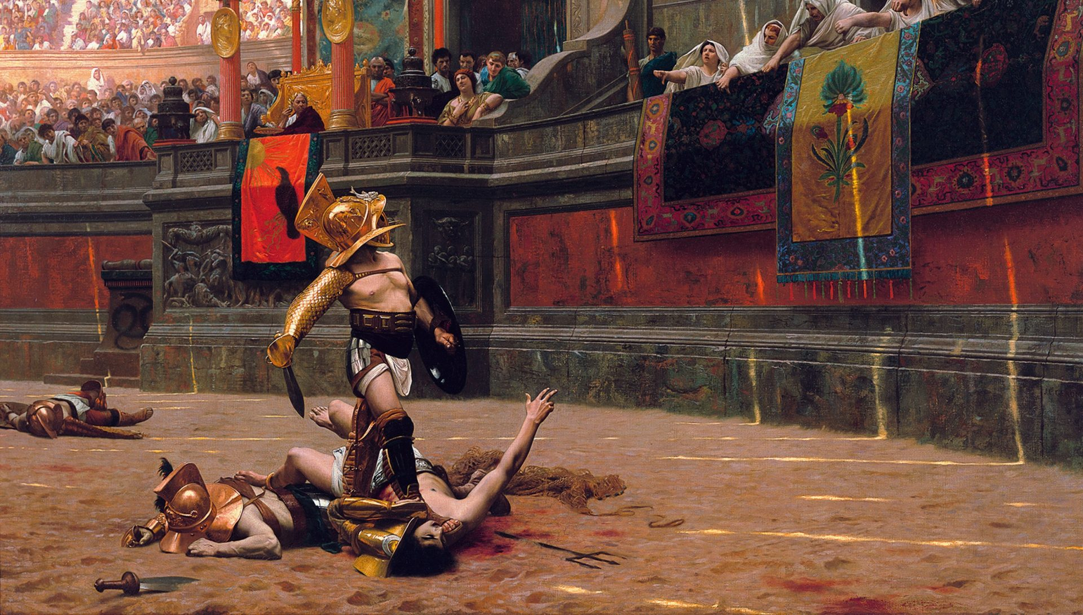
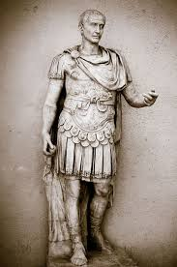
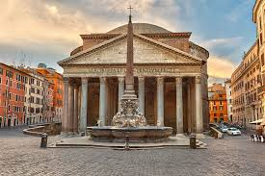
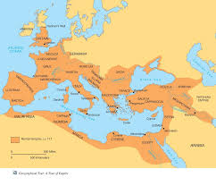
Rome in 20 Minutes
What do you already know about Rome?

Slide 3
Essential Questions:
How did the geographic, political, economic, religious, and social structures affect the development and eventual decline of Rome?
What contributions from ancient Rome impact our society today?
How can perspective influence the views and beliefs people have in society?

Slide 4
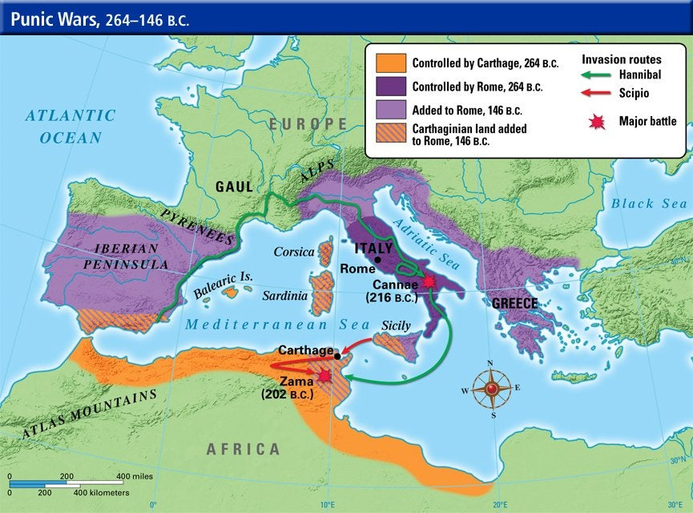
Guiding Question
What are the advantages of Rome in its location?
Why is it said that Rome dominates the Mediterranean?

Slide 5
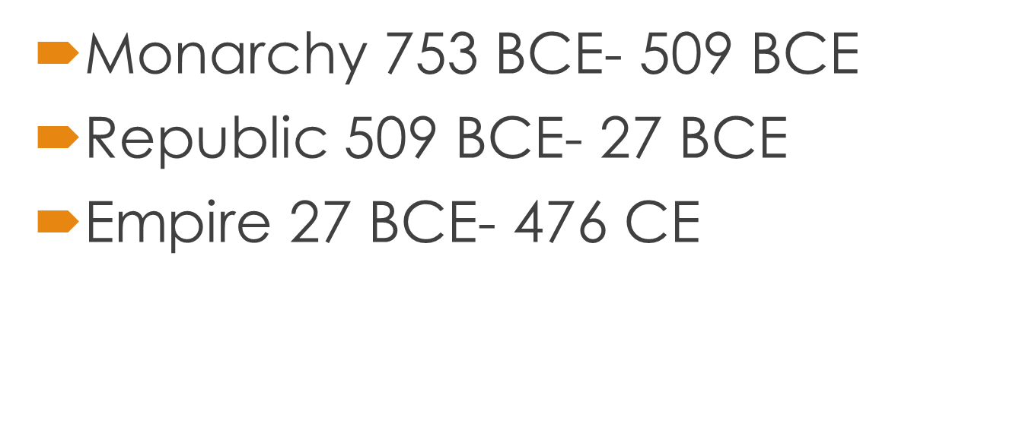
Development & Expansion
Monarchy:
Kings rule
People did not participate
Empire:
Emperor held all the power
Provinces were administered by governors who reports to emperor
Timeline
Republic:
Based on participation of citizens
Administered by a senate (300 magistrates – appointed by 2 consuls ( who are elected by the people)

Slide 6
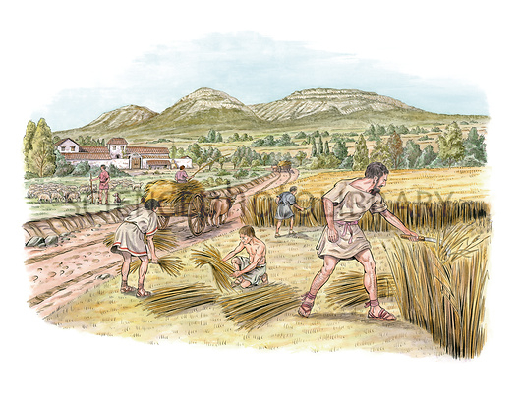
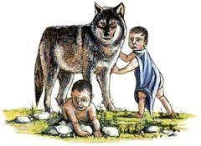
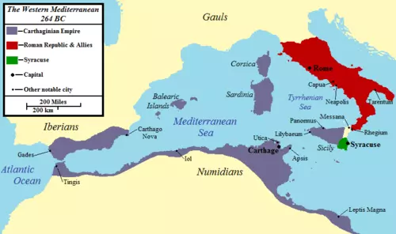
Development and Expansion
Location: Ideal fertile plain for agriculture, river for irrigation and transportation, surrounded by seven hills for protection
Legend: Romulus and Remus
Abandoned on the shores of the Tiber River
Suckled by a she-wolf, adopted by a Shepard
Romulus killed Remus and adopted the city that bears his name
Monarchy to Republic to Empire
As Rome became more structured and organized it slowly began a series of conquests
By the Second Century BCE it held most of the surrounding territory in the Mediterranean
Roman Empire

Slide 7
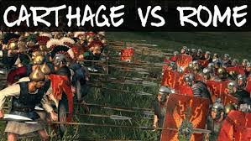
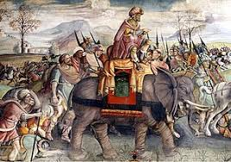
Development and Expansion
Punic Wars: 264-146 BCE
Destroyed Carthage
Took Possession of Corsica, Sardinia and Sicily
Victory over the Greeks 133 BCE
Dominated entire Mediterranean Perimeter

Slide 8
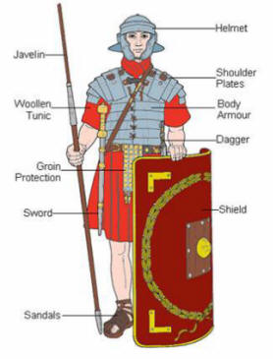
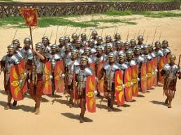
Army & Conquest
Strict Discipline
Insubordination Severely punished
Many LEGIONS
Each legion had 5000-6000 ‘legionaries’
Led by a TRIBUNE
Within Legion is a cohort of 500-600 men
Within Legion are centuries of 80-100 soldiers
Led by a CENTURION
Daily Life in the Roman Army
First impression of the army structure?
Why would Auxiliaries be willing to serve in the army?

Slide 9
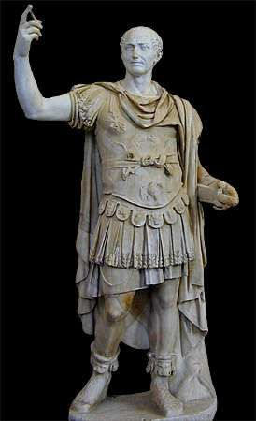
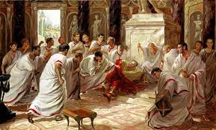
Army and Conquest
Julius Caesar- Pure dominance and power (1/10 )
Conquered Gaul in 49 BCE
Instead of disbanding his army he returned with them and seized power
Civil War raged for 4 years
Forced the Senate to declare him DICTATOR in 46BCE & DICTATOR FOR LIFE in 44 BCE
Needless to say this did not sit well with the Senate
He was ASSASSINATED in 44 BCE
They stabbed him 23 times to death in a location adjacent to the Theatre of Pompey on the Ides of March 15 March 44 BC.
*He change the Republic into an Empire where one ruler ruled for life

Slide 10
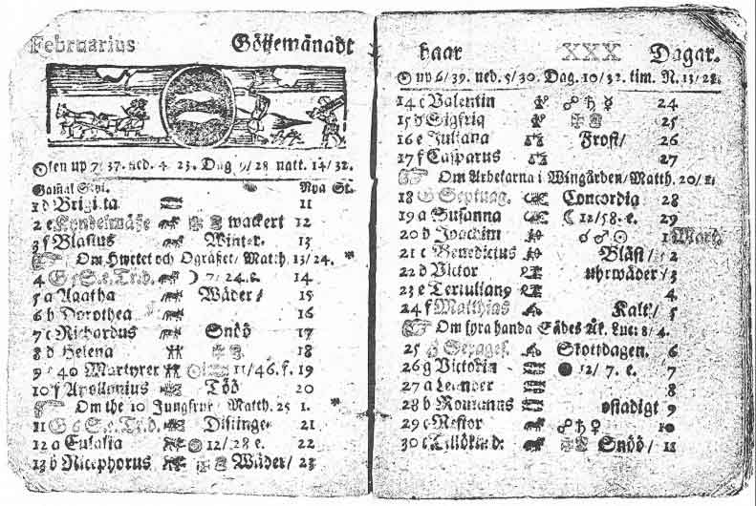
Army & Conquest
Besides conquering new territories, what else do you think Caesar is known for?
Reorganized the Roman State
Assisted the poor by giving them work or land
Organized the government into provinces
Granted citizenship to local leaders
Reformed the taxes to make them fairer
New Calendar (basis of our present day calendar)
Homework:
page 116-119 #1-7
Notes:
Workbook pages

Slide 11
Pax Romana
Pax Romana
27BCE- 180CE
The empire protected and governed individual provinces, permitting each to make and administer its own laws while accepting Roman taxation and military control.
Following the death of Caesar power was shared by Marc Antony and Octavian
The Battle of Actium 31BCE
Octavian Defeats Marc Antony
Senate bestowed Octavian the title of Augustus (the First Roman Emperor)
Augustus reigned for 44 years until his death in 14 CE

Slide 12
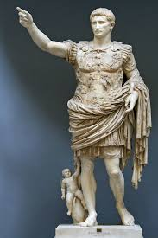
Pax Romana: under Augustus
Beginning of Pax Romana (lasted for 2 centuries)
Administration and collection of taxes was improved
Rome was beautified and large scale public works were undertaken to create jobs
Permanent professional army was formed
Land in the conquered provinces was distributed to retired soldiers
Inhabitants of the provinces were more easily given access to Roman Citizenship

Slide 13
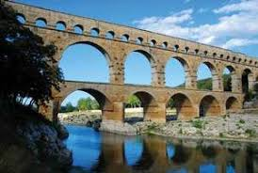
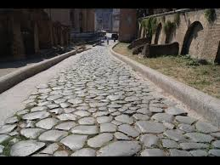
Pax Romana
Infrastructure
Engineering an Empire 2&3/10
Roman Roads
A road system to travel throughout the Empire
Transport Goods, tax money and relay emperor’s orders
Flagstone roads
Built by legionairies
Technology was so advance some still exists today.
Aqueducts
Water seeks its lowest level so water can run from one area to another
Brought water to the city from the mountains
First system of running water
Arch was used to support the aqueducts

Slide 14
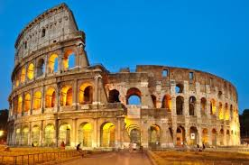
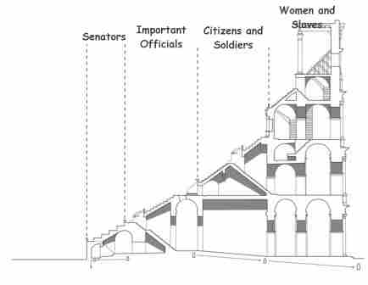
The Coliseum
Engineering an Empire 5-6/10
Construction on the Colosseum was started in 72 AD by the emperor Vespasian. It was finished eight years later in 80 AD.
50,000 people
Fun Facts
Certain classes of people were banned from attending the Colosseum. They included former gladiators, actors, and gravediggers.
There were 32 different trap doors underneath the floor of the stadium.
The first ever games at the Colosseum lasted for 100 days and included more than 3,000 gladiator fights.
The west exit was called the Gate of Death. This was where dead gladiators were carried out of the arena.
The southern side of the Colosseum collapsed during a large earthquake in 847.

Slide 15
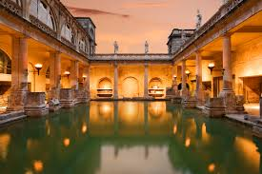
Public Baths
Wealthy people sometimes had their own private baths inside their homes.
Men and women bathed at different times or in different areas of the baths.
Items were often stolen in the baths by pickpockets and thieves.
The Roman Bath House
Visit to the Baths
What was the purpose of the Roman Baths?
Bath, Socialize, Exercise
Apodyterium - This room was the changing room where visitors would take off their clothing before entering the main area of the baths.
Tepidarium - This room was a warm bath. It was often the main central hall in the bath where the bathers met and talked.
Caldarium - This was a hot and steamy room with a very hot bath.
Frigidarium - This room had a cold bath to cool the bathers at the end of a hot day.
Palaestra - The palaestra was a gymnasium where bathers could exercise. They might lift weights, throw a discus, or play ball games.
https://www.ducksters.com/history/ancient_rome/roman_baths.php

Slide 16
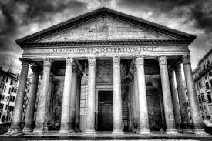
The Pantheon
The Pantheon Video
As you watch write down 3 interesting facts about the Pantheon
What was the purpose of the Pantheon?
Originally built as a temple to the gods of Ancient Rome
What is it used for today?
Since the 7th century, the Pantheon has been used as a Roman Catholic church.

Slide 17
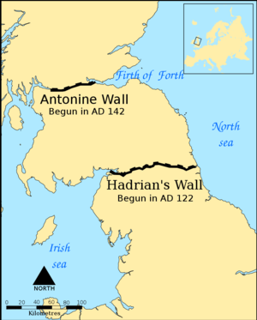
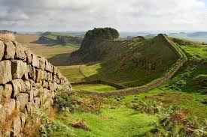
Hadrian’s Wall
Engineering an Empire-Hadrian’s Wall
A defensive fortification in the Roman province of Britannia – after many unsuccessful attempts to conquer modern day Britain (under Cesar ) Emperor Hadrian wanted to protect land that was already Roman
Runs a total of 73 miles in northern England.
The defensive fortification started its construction in 122 A.D and finished six years later.
The wall was built from east to west between castles and forts.

Slide 18
Thursday, January 9th Day 4
Today: Fall of Rome
Learning Intention: Understand the components that led to the fall of Rome.
Success Criteria: The student can identify why the Roman Empire collapsed
(Combination of factors? Were all these factors connected? Was it only 1 reason)
During the lesson
The Roman Empire collapsed in the 3rd century due to…

Slide 19
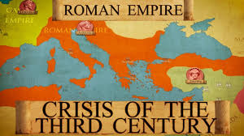
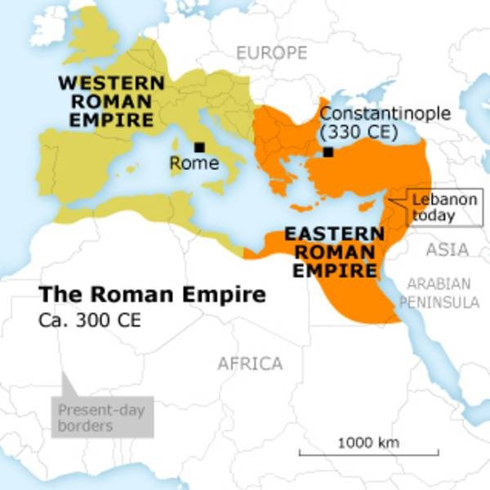
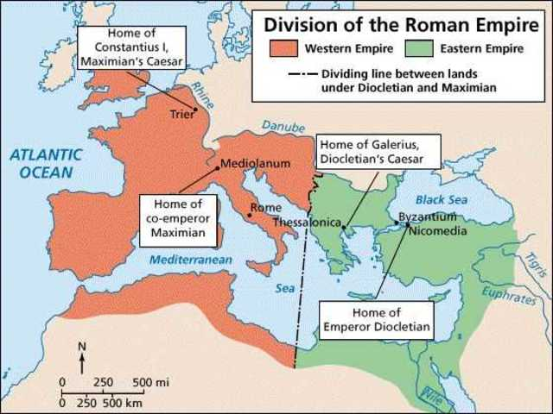
The Fall of Rome
Crash Course
The Abuse of Power
Crisis of the Third Century, Roman Empire nearly collapsed under the combined pressures of invasion, civil war, plague, and economic depression. Over a 50-year period 26 emperors claimed the title of emperor
Army was the only true power
soldiers were loyal to their general rather than the emperor or Roman State
Provinces slowly took back independence
395 CE empire split in two

Slide 20
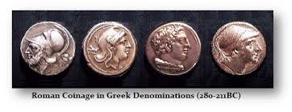
The Fall of Rome
Financial Troubles
Rich got richer
Poor got poorer
To deal with financial troubles taxes were increased
Workers, artisans and farmers seeking employment had to compete with slaves
Who would you hire? A free slave or an artisan you need to pay?
Cities were filled with thousands of jobless people

Slide 21
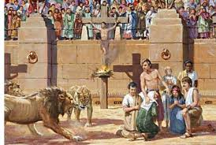
The Fall of Rome
Rise of Christianity
Since the 1st Century the disciples of Jesus were spreading the a new religion
Poor people, slaves and women were willing to follow
Why would the this group of people become loyal followers?
Rome did not agree with the emerging religion and followers were persecuted, some even thrown to the lions in the Coliseum
By mid 3rd Century one tenth of Rome was Christian.

Slide 22
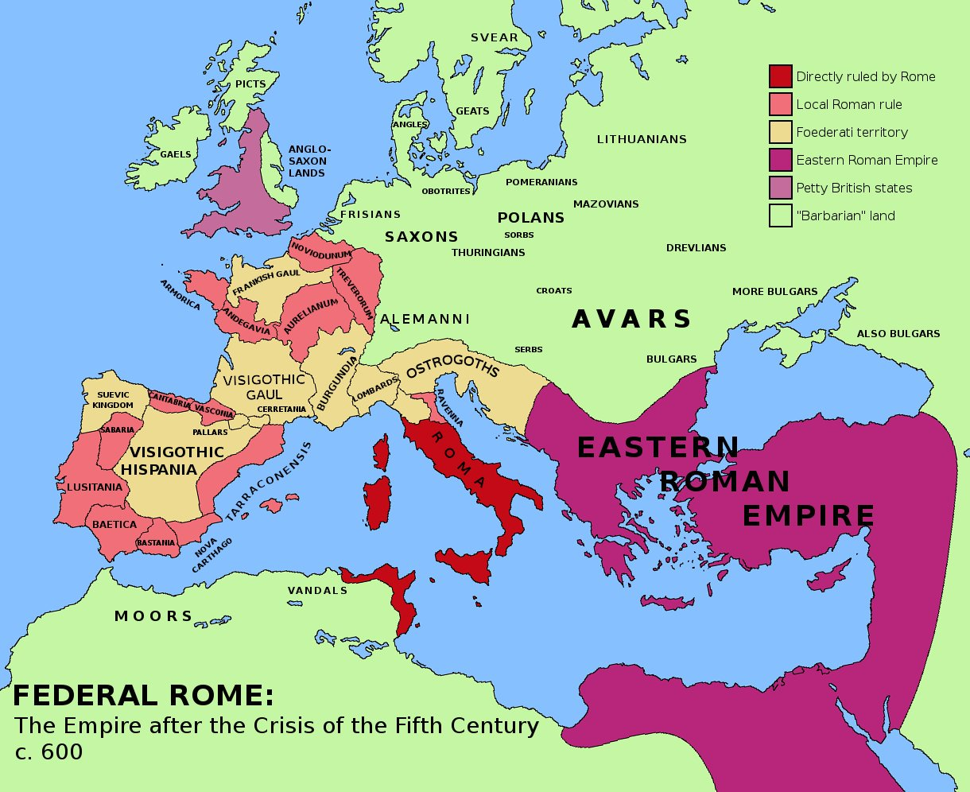
The Fall of Rome
Rome Invaded
Foreigners started to invade Roman territory
Borders were large and difficult to defend
476CE the city itself was attacked
Emperor Romulus Augustulus was overthrown
THE END OF ROME
Rome divided into numerous smaller kingdoms
The new capital (Constantinople in the Byzantine empire) lasted for another thousand years.

Slide 23
YOUR TASK
How Rome Fell
Using your notes from the Fall of Rome
Write an opinion piece indicating what you believe was the ultimate reason Rome fell.
You will need to discuss all of the factors indicated in the lesson
DO YOU BELIEVE ROME FELL BECAUSE OF ONE SINGULAR FACTOR, ALL OF THE FACTORS COMBINED, OR DID ONE FACTOR LEAD TO THE NEXT?
Examples of how to start
Ancient Rome fell because of a combination of factors
Ancient Rome fell because of this one main factor which led to all the other factors
Ancient Rome fell because each factor led to the next

Slide 24
The Fall of Rome- Opinion piece
Ancient Rome fell because of a combination of factors
Ancient Rome fell because of this one main factor which led to all the other factors
Ancient Rome fell because each factor led to the next

Slide 25
Footnotes
https://www.youtube.com/watch?v=P5e7cl19Ha0
https://www.youtube.com/watch?v=o3v3GfLnQX8
https://www.google.ca/search?safe=strict&rlz=1C1GCEA_enCA759CA759&biw=1366&bih=626&tbm=isch&sa=1&ei=kkP8W6zZEJHl_QaWs7vwAw&q=roman+legions+equipment&oq=roman+legions+equipment&gs_l=img.3...40704.50184..50453...0.0..1.246.1024.7j2j1......1....1..gws-wiz-img.......0j0i30j0i5i30j0i8i30j0i24.BZo0X-Uv25U#imgrc=0-eCfD8CkN3_RM:

